Slide 1
LECTURE 03
The Project Management Process Groups: A Case Study

Slide 2
Learning Objectives
Describe the five project management process groups, the typical level of activity for each, and the interactions among them
Understand how the project management process groups relate to the project management knowledge areas
Discuss how organizations develop information technology (IT) project management methodologies to meet their needs

Slide 3
Learning Objectives
Review a case study of an organization applying the project management process groups to manage an IT project, describe outputs of each process group, and understand the contribution that effective initiating, planning, executing, monitoring and controlling, and closing make to project success
Review the same case study of a project managed with an agile focus to illustrate the key differences in approaches
Describe several templates for creating documents for each process group

Slide 4
PM Process Groups
A process is a series of actions directed toward a particular result
Project management can be viewed as a number of interlinked processes
The project management process groups include
initiating processes
planning processes
executing processes
monitoring and controlling processes
closing processes

Slide 5
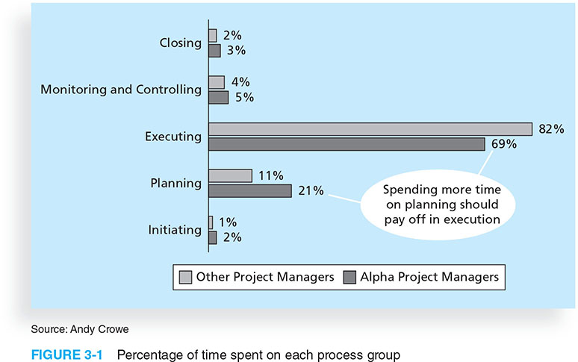
Figure 3-1. Percentage of Time Spent on Each Process Group

Slide 6
Important!
“The project manager is ultimately responsible for the success or failure of the project”

Slide 7
Mapping the Process Groups to the Knowledge Areas
You can map the main activities of each PM process group into the ten knowledge areas using the PMBOK® Guide, Fifth Edition, 2013
Note that there are activities from each knowledge area under the planning process groups

Slide 8
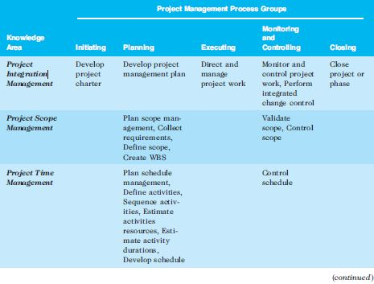
Table 3-1. Mapping PM Process Groups to Knowledge Areas*

Slide 9
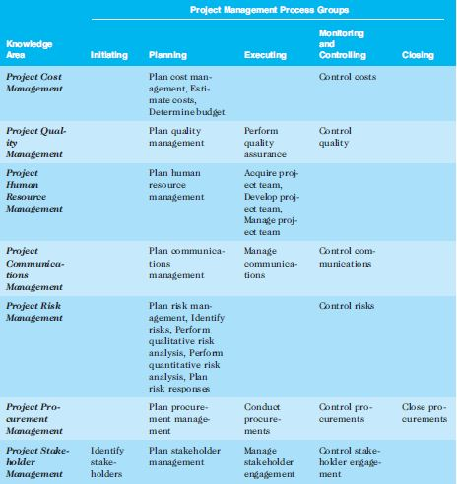
Table 3-1. Mapping PM Process Groups to Knowledge Areas*

Slide 10
Table 3-1. Mapping PM Process Groups to Knowledge Areas*

Slide 11
Project Pre-initiation
It is good practice to lay the groundwork for a project before it officially starts
Senior managers often perform several pre-initiation tasks, including the following:
Determine the scope, time, and cost constraints for the project
Identify the project sponsor
Select the project manager
Develop a business case for a project (see Table 3-2 for an example)
Meet with the project manager to review the process and expectations for managing the project
Determine if the project should be divided into two or more smaller projects

Slide 12

Project Initiation
Initiating a project includes recognizing and starting a new project or project phase
The main goal is to formally select and start off projects
Table 3-3 shows the project initiation knowledge areas, processes, and outputs

Slide 13
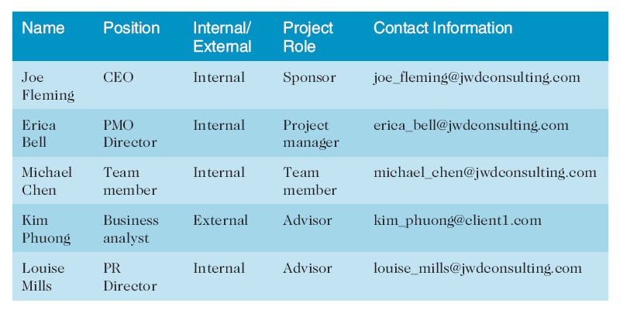
Table 3-4. Stakeholder Register

Slide 14
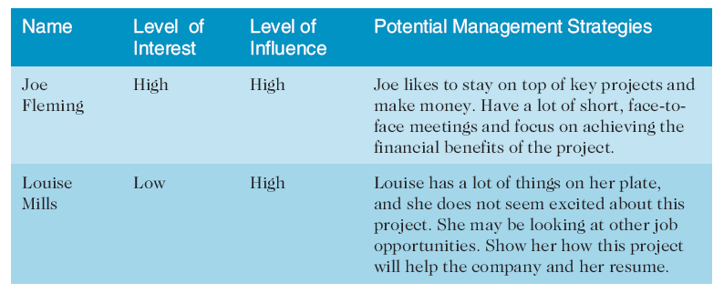
Table 3-4. Stakeholder Management Strategy

Slide 15
Project Charters and Kick-off Meetings
Charters are normally short and include key project information and stakeholder signatures
It’s good practice to hold a kick-off meeting at the beginning of a project so that stakeholders can meet each other, review the goals of the project, and discuss future plans

Slide 16
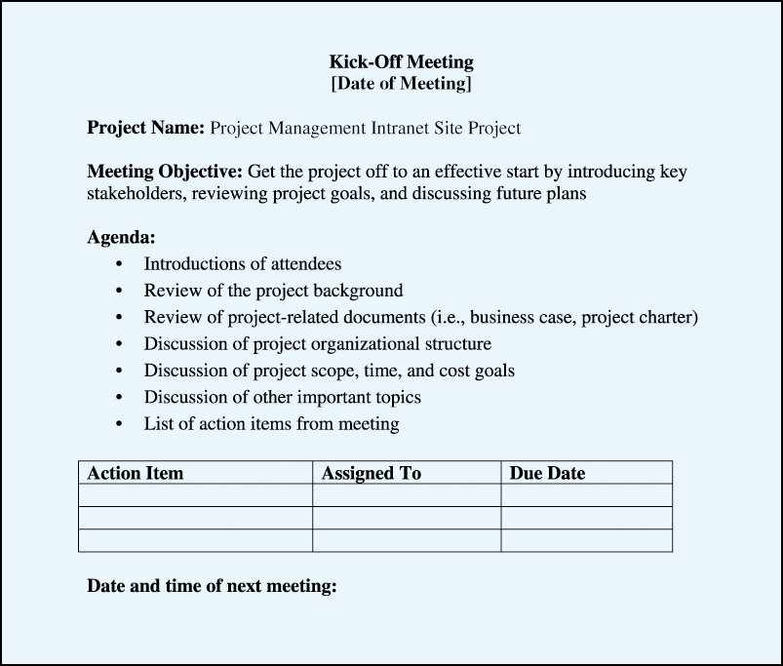
Figure 3-2. Kick-off Meeting Agenda

Slide 17
Project Planning
The main purpose of project planning is to guide execution
Every knowledge area includes planning information
Key outputs include:
A team contract
A project scope statement
A work breakdown structure (WBS)
A project schedule, in the form of a Gantt chart with all dependencies and resources entered
A list of prioritized risks (part of a risk register)

Slide 18
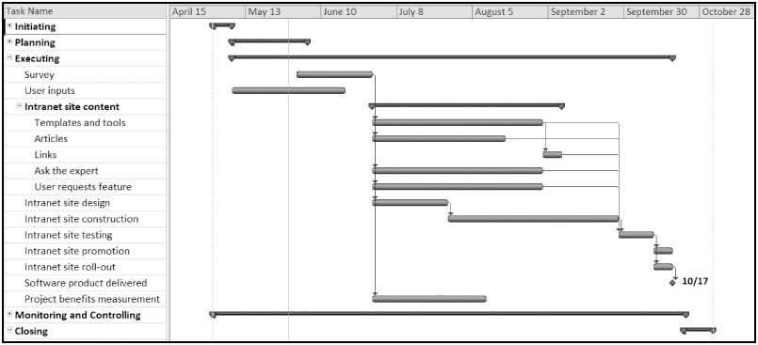
Figure 3-4. Project Baseline Gantt Chart

Slide 19
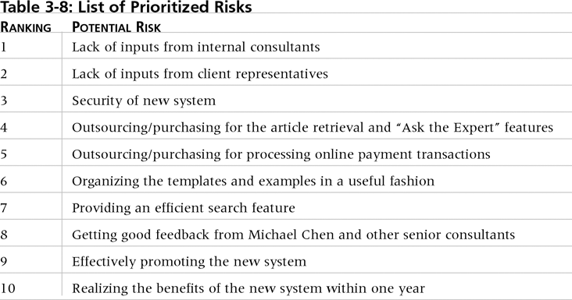
Table. 3-10. List of Prioritized Risks

Slide 20
Project Executing
Usually takes the most time and resources to perform project execution
Project managers must use their leadership skills to handle the many challenges that occur during project execution
Table 3-11 lists the executing processes and outputs. Many project sponsors and customers focus on deliverables related to providing the products, services, or results desired from the project
A milestone report can help focus on completing major milestones

Slide 21
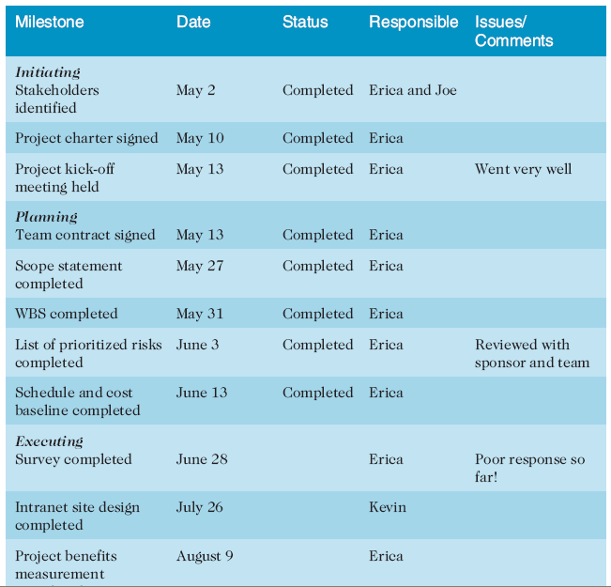
Part of Milestone Report

Slide 22
Project Monitoring & Controlling
Involves measuring progress toward project objectives, monitoring deviation from the plan, and taking correction actions
Affects all other process groups and occurs during all phases of the project life cycle
Outputs include performance reports, change requests, and updates to various plans

Slide 23
Project Closing
Involves gaining stakeholder and customer acceptance of the final products and services
Even if projects are not completed, they should be closed out to learn from the past
Outputs include project files and lessons-learned reports, part of organizational process assets
Most projects also include a final report and presentation to the sponsor/senior management

Slide 24
Templates
Table 3-20 lists the templates available on the companion website and the author’s site at www.pmtexts.com or www.kathyschwalbe.com

Slide 25
Chapter Summary
The five project management process groups are initiating, planning, executing, monitoring and controlling, and closing
You can map the main activities of each process group to the nine knowledge areas
Some organizations develop their own information technology project management methodologies
The JWD Consulting case study provides an example of using the process groups and shows several important project documents
The second version of the same case study illustrates differences using agile (Scrum). The biggest difference is providing three releases of useable software versus just one

Slide 26
Questions & answers

